Slide 1







Car Black Box Project Using PIC18F4580
BY
KALAIVANAN D

Slide 2
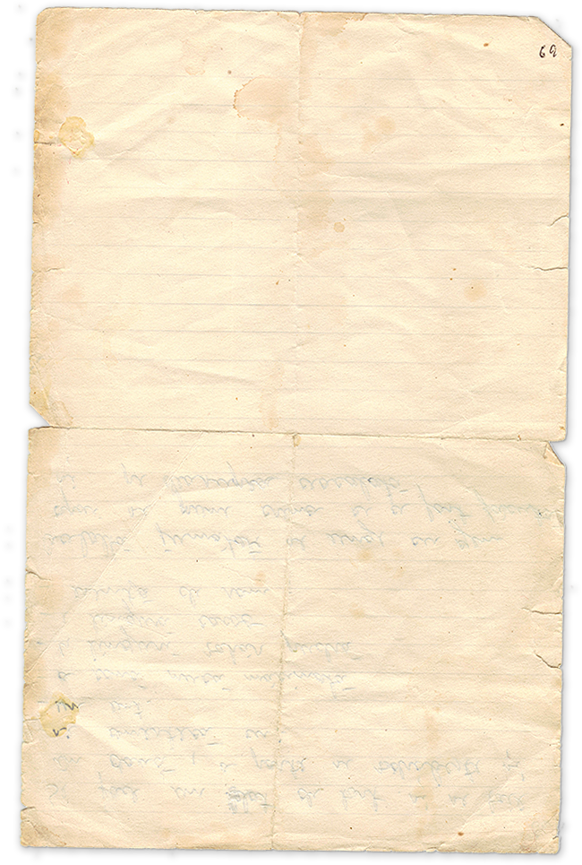
INTRODUCTION
The Car Black Box monitors key vehicle parameters and records data, crucial for accident investigations and vehicle maintenance.
The system incorporates a Matrix Digital Keypad (MKP) for controlling the gear shifts (increase/decrease), and a collision detection mechanism.
The PIC18F4580 microcontroller is used to process data from sensors, control the dashboard interface, and handle the gear shift logic.
OBJECTIVE
To develop a car black box that records vehicle data, such as speed and location.
To use MKP for gear shifting control (increase/decrease) and collision event detection.
To ensure that after a collision, the gear shifting system is disabled (no increase or decrease allowed after collision).

Slide 3
What is an Embedded System?
An embedded system is a specialized computing device designed to perform specific tasks within a larger system. Unlike general-purpose computers, it optimizes efficiency, reliability, and performance for its particular application, integrating tightly with both hardware (like microcontrollers or microprocessors) and software.
TYPES OF EMBEDDED SYSTEMS
Real-Time Embedded Systems
Hard Real-Time Systems
Soft Real-Time Systems
Standalone Embedded Systems
Networked Embedded Systems
Mobile Embedded Systems

Slide 4
MICROCONTROLLER:
A microcontroller is an integrated circuit that includes a CPU, memory (RAM, ROM/Flash), and peripherals (I/O ports, timers, ADCs) on a single chip.
Designed for specific control applications and optimized for embedded systems.
Examples: PIC18F4580, Arduino, STM32.
MICROPROCESSOR:
A microprocessor is a central processing unit (CPU) that requires external components like memory and I/O interfaces to function.
Used in general-purpose computing systems where high processing power is needed.
Examples: Intel Core i7, AMD Ryzen, ARM Cortex-A series.

Slide 5
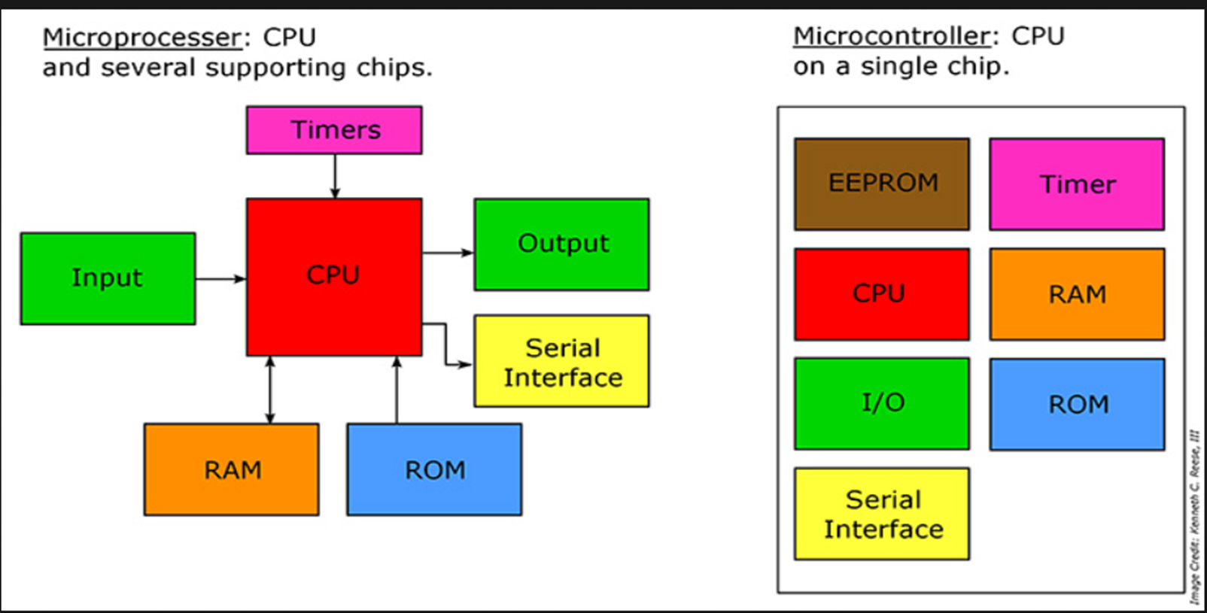

Slide 6
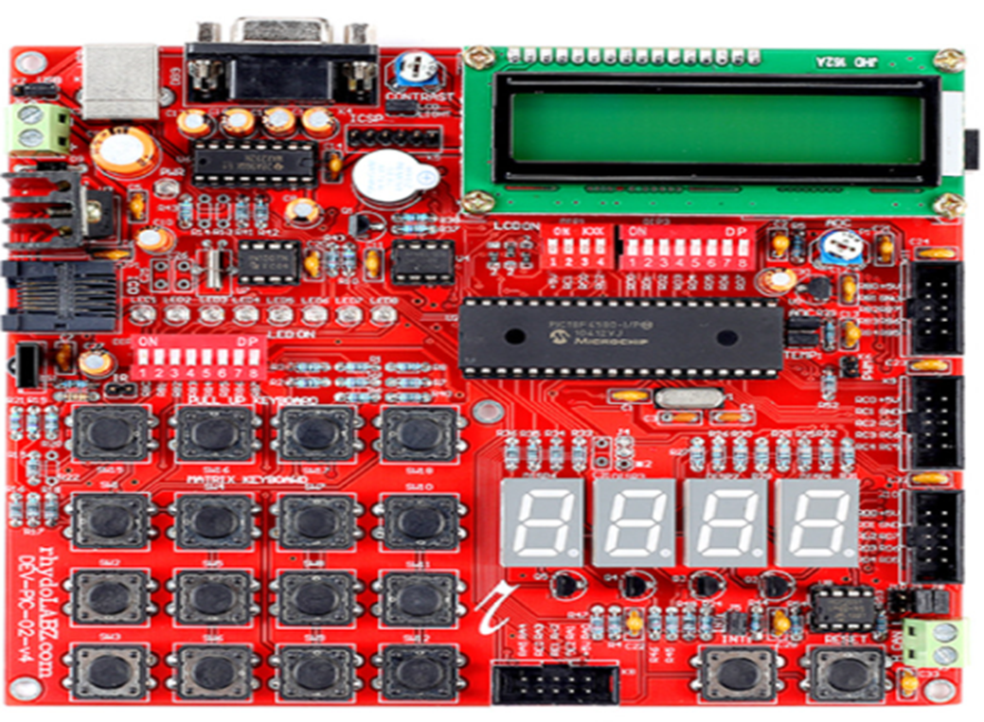
PIC18F4580 DEVELOPMENT BOARD

Slide 7
METHODS AND CONCEPTS USED
Microcontroller: PIC18F4580 is used to interface with the MKP, sensors, and memory.
MKP Integration: Matrix Digital Keypad (MKP) allows user input for controlling the gear shift:
MKP1: Increases the gear (up to a limit).
MKP2: Decreases the gear (down to a limit).
MKP3: Detects collision (simulates crash event).
Sensors: Speed, GPS, and collision detection sensors.
Data Logging: Logs data to memory, accessible via the user interface.
Problem Statement
Problem: A need for a system that tracks vehicle data (speed, location) and ensures safe operation by controlling gear shifts with respect to driving conditions.
Challenge: Developing a system that restricts gear shifting during collision and provides simple controls via MKP.

Slide 8
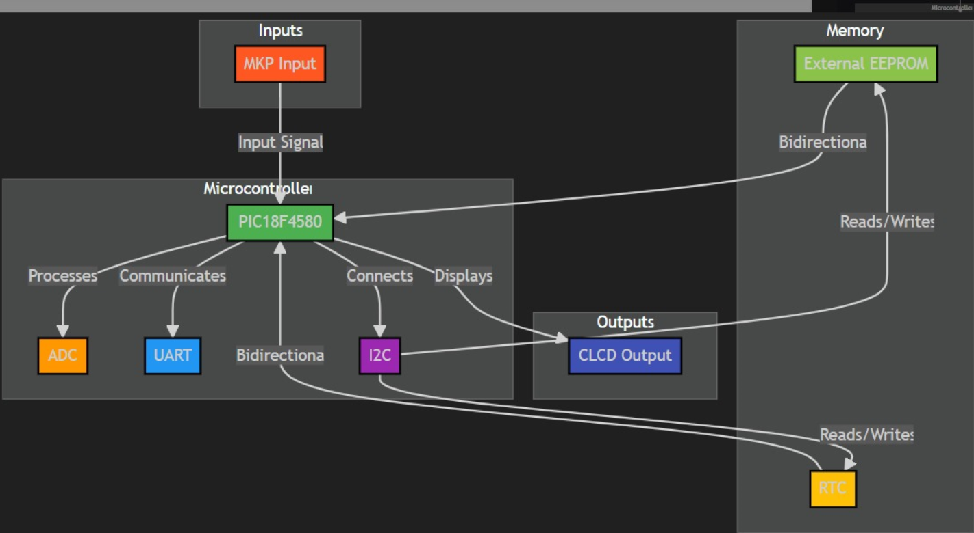
BLOCK DIAGRAM

Slide 9
PROCEDURE TO IMPLEMENT
SYSTEM DESIGN:
Use PIC18F4580 to control and process data from MKP, sensors, and memory.
Interface MKP for gear control (MKP1, MKP2, MKP3,MKP4,MKP5).
MATRIX KEYPAD:
MKP1: Increases gear, with collision detection to prevent shifting beyond the maximum gear limit.
MKP2: Decreases gear, with a floor limit to prevent shifting below the minimum gear.
MKP3: Detects collisions, preventing further gear shifting if a collision is detected.
MKP4: Enter to trigger the event or process.
MKP5: Return to the menu or main screen.
DATA LOGGING:
Record and store speed, time, and events.
USER INTERFACE:
Display the current gear, speed, and status.
Testing
Test gear shifting functionality and ensure collision detection disables gear change.

Slide 10
Advantages
Real-time Data Logging: Vehicle parameters are logged continuously.
Gear Control: MKP allows manual gear adjustments based on user input.
Collision Detection: Disables further gear changes after a crash event.
User Interface: Simple dashboard for viewing and managing vehicle data.
Disadvantages
Limited Gear Control Post-Collision: Once a crash occurs, no further gear shifting is possible, limiting the flexibility.
Power Consumption: Continuous operation may lead to higher power usage over long durations.

Slide 11
ARCHITECTURE OF PIC18F4580
Overview: The PIC18F4580 is a high-performance microcontroller with integrated peripherals to control sensors, data logging, and user interface.
Key Components:
CPU: Executes control logic for MKP inputs and sensor data.
Memory: Flash memory and EEPROM for program storage and data storage.
I/O Ports: Interface with MKP and sensors.
Communication: UART/USB for downloading logs or updates.
Peripheral Modules: Timers, ADCs for sensor input, and I/O for MKP.

Slide 12
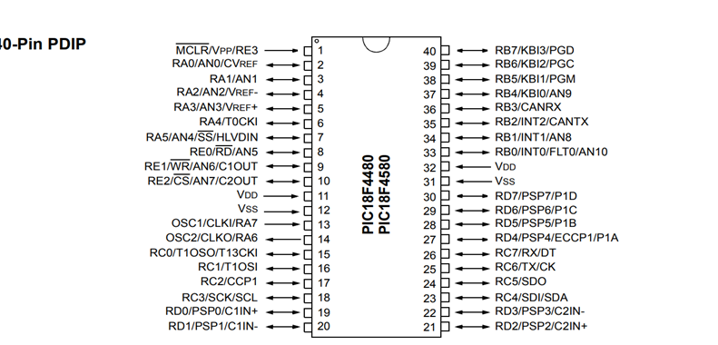
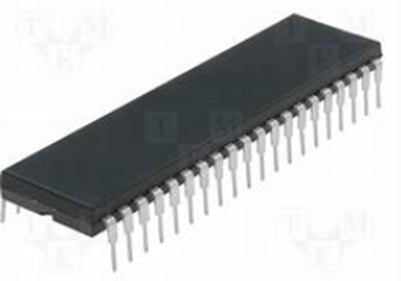
PIN DIAGRAM OF PIC18F4580

Slide 13
DASHBOARD AND MENU
Background: White with light blue accents.
Content/Menu:
View Log: View the recorded data including speed, time, and event logs.
Download Log: Download logs to an external device for analysis.
Set Time: Set the system time for proper event logging.
Clear Log: Clear the stored data logs.
Control Parameters:
MKP1: Press to increase the gear until the collision condition is met.
MKP2: Press to decrease the gear until the minimum limit is reached.
MKP3: Detects a collision, disables gear changes until reset.
MKP4: Enter to trigger the event or process.
MKP5: Return to the menu or main screen.

Slide 14
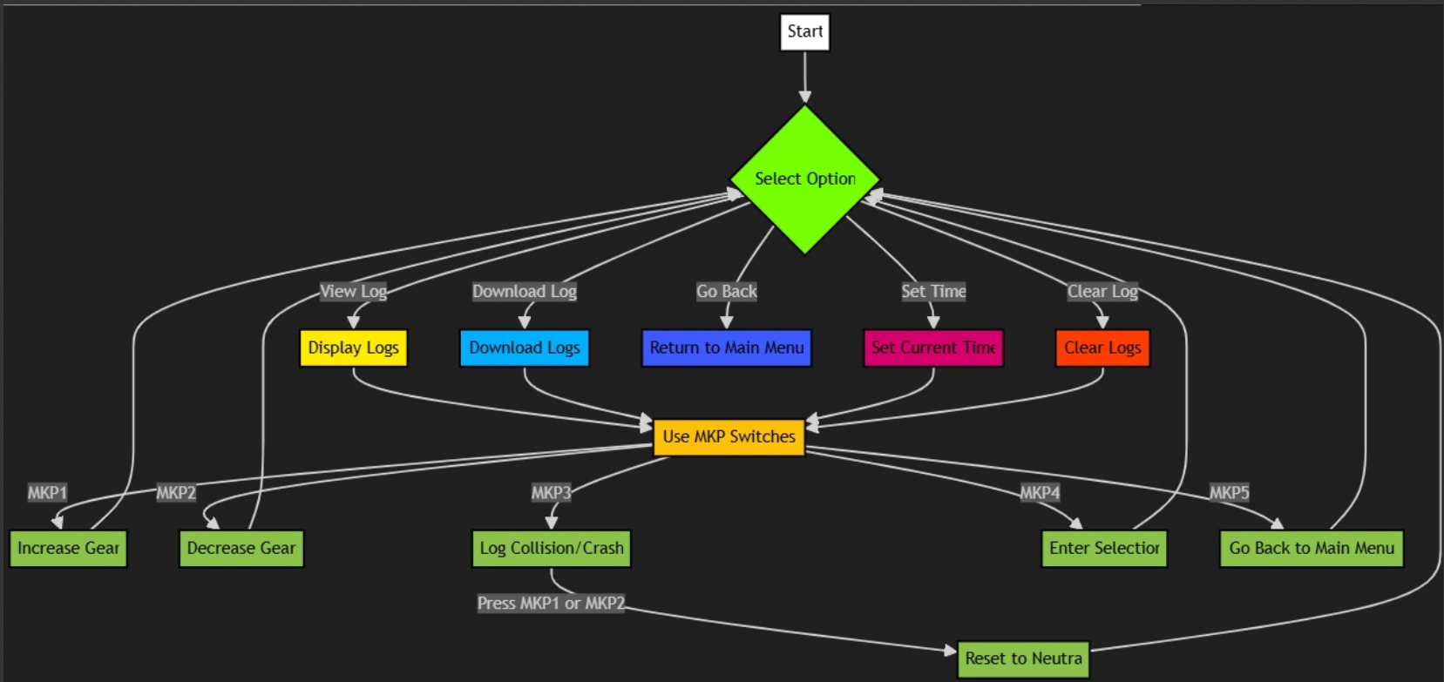
FLOW CHART

Slide 15
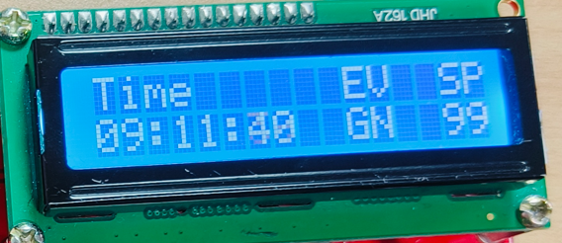
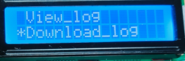
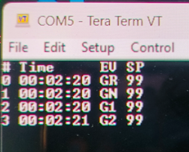
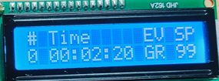
OUTPUT

Slide 16
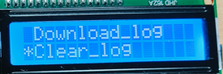
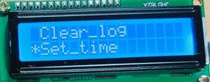
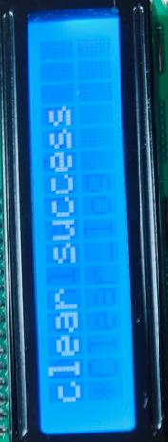
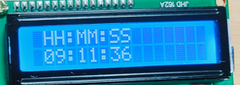
OUTPUT

Slide 17
FUTURE SCOPE
•Smart Integration with Car ECU: Allowing the system to work seamlessly with the car’s existing control units for enhanced data collection.
•Expanded Sensor Array: Adding additional sensors for monitoring tire pressure, fuel consumption, etc.
•Mobile Application Integration: Viewing and downloading logs via a smartphone app.
•Artificial Intelligence: Using AI to predict potential issues based on vehicle data (e.g., potential accidents, maintenance needs).

Slide 18
CONCLUSION
•The car black box project using the PIC18F4580 and Matrix Digital Keypad offers a reliable, simple solution for vehicle monitoring and data logging.
•The integration of gear control, collision detection, and data storage adds value for both real-time tracking and accident analysis.
•Future improvements can make the system even more intelligent and interconnected with modern car technologies

Slide 19
QnA
Time

Slide 20
Thank
You

